Slide 1
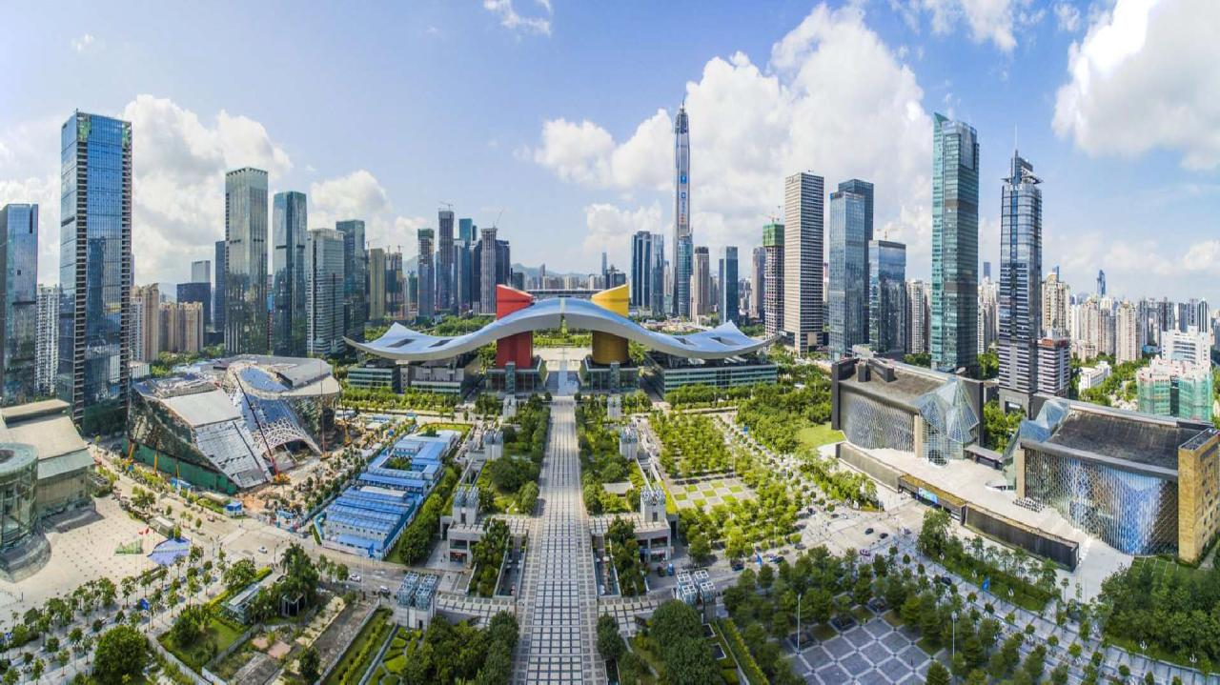














Slide 2





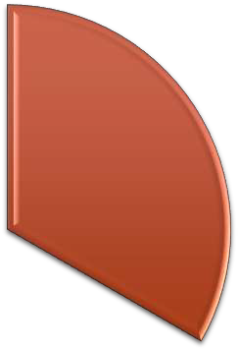





Diverse Team
Dynamic
Location
Delightful
Weather

Slide 3
Dynamic
Location

Slide 4






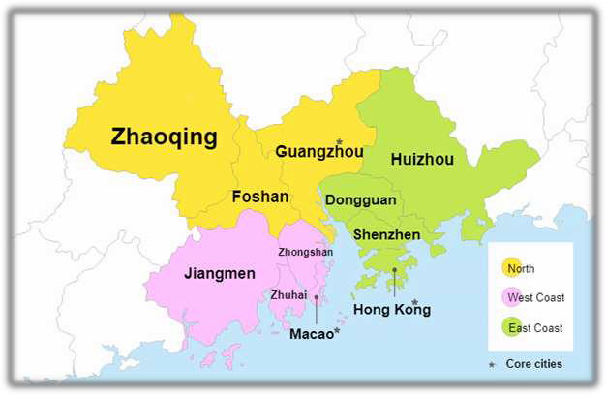

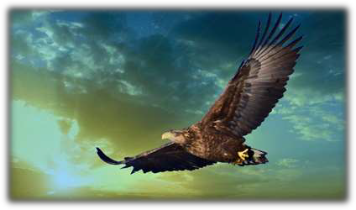
Shenzhen
The City of Kun-Peng
鹏城

Slide 5
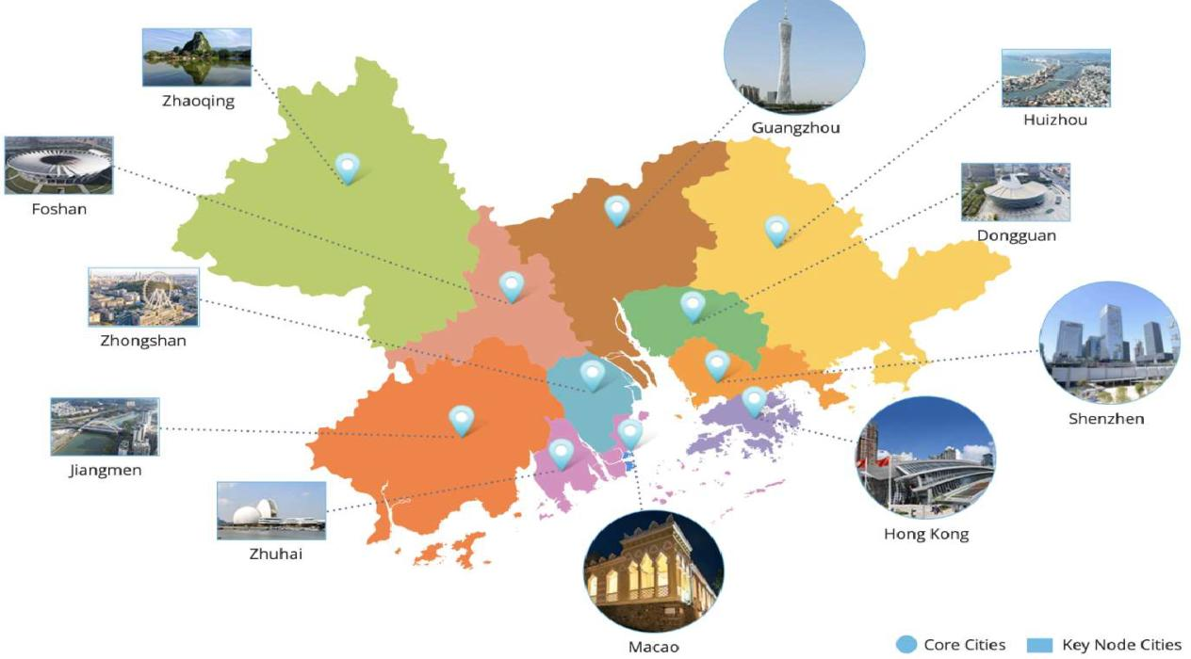






Slide 6






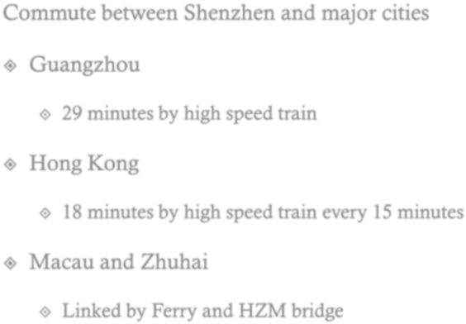
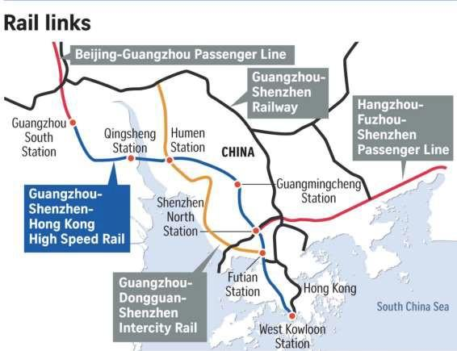







Slide 7
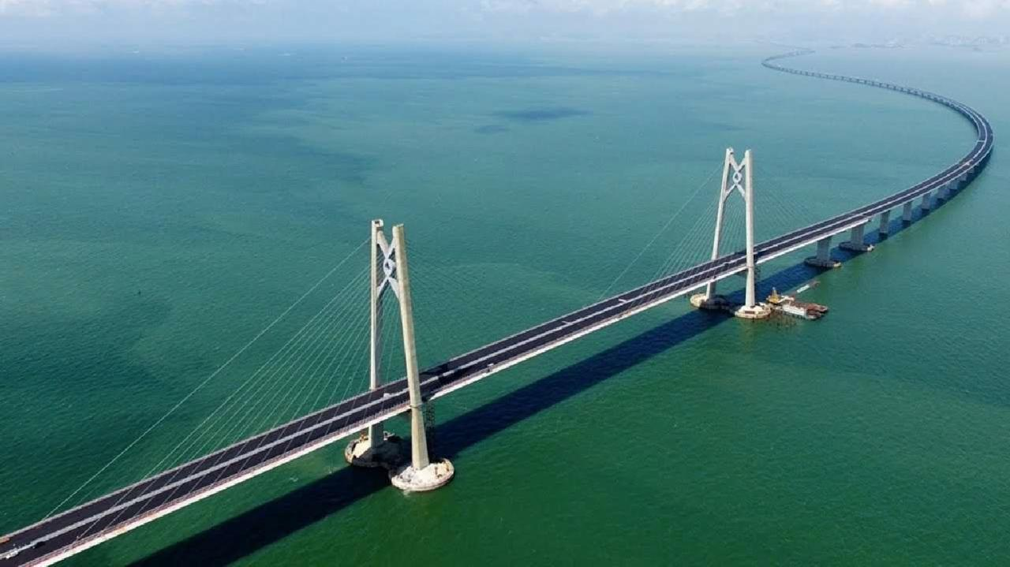





The world’s longest sea-crossing bridge (34 mi) linking Hong Kong, Macau and
Zhuhai with an undersea tunnel and four artificial islands

Slide 8













Slide 9




Industrial Sponsorships for
More Travel Supports
400+ Travel Grants
Onsite daycares
Onsite Career Fair Sponsored by Companies
Global giants
headquartered in Shenzhen
Exhibitions on Vision-Enabled
Technologies
120+ exhibition booths
Many computer vision startups

Slide 10

Delightful Weather
Dynamic Location

Slide 11
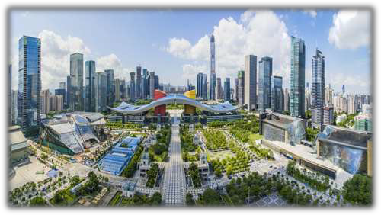
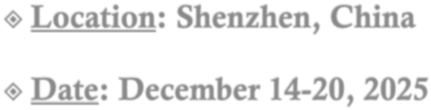






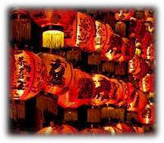
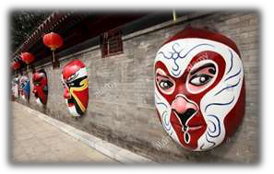
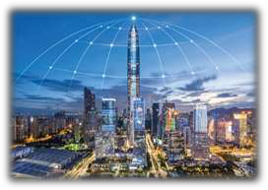
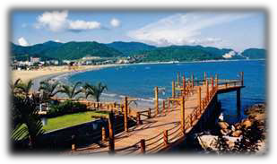

Slide 12






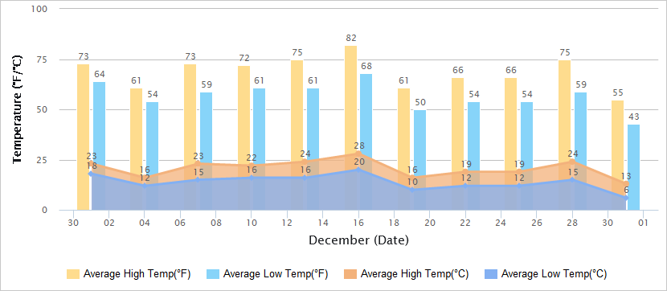
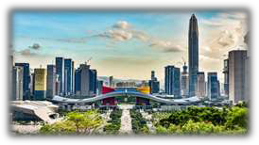
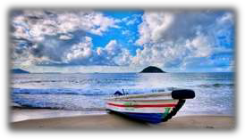
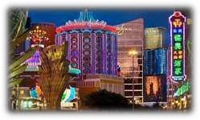
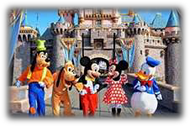
22ºC
72ºF
55ºF
13ºC
Shenzhen • Greater Bay Area
Xichong Beach • Shenzhen
Sands • Macau
Disneyland • Hong Kong

Slide 13










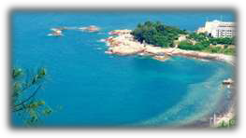
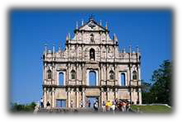
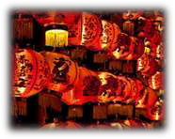
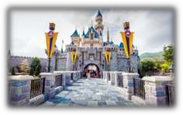
Holiday season starts in late November
ICCV25: December 14-20, 2025
New Year Holiday

Slide 14
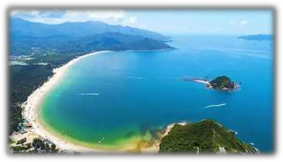
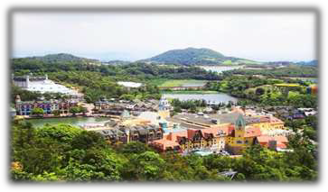
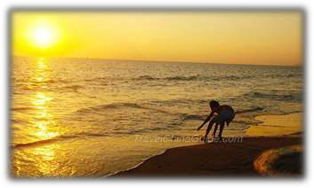
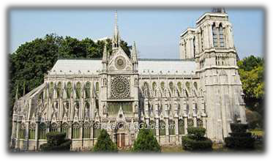
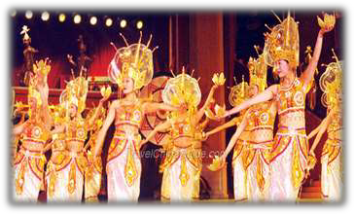
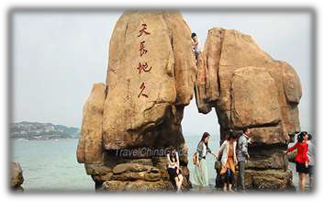
Xichong Beach
Overseas Chinese Town East
Camping on Xichong Beach
Window of the World
Folk Culture Villages
Sunbathing on Dameisha Beach

Slide 15



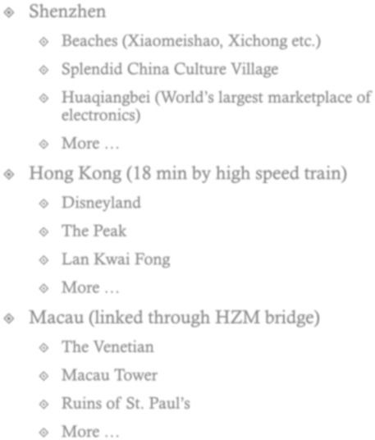
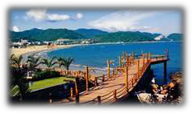








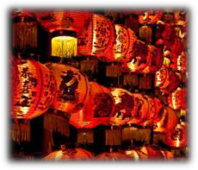
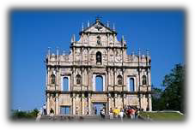






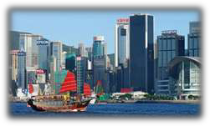




Natural Sceneries
Traditional Cultures
Modern energies
Family Friendly

Slide 16
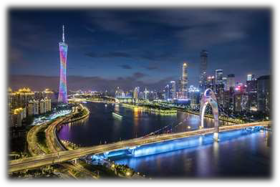
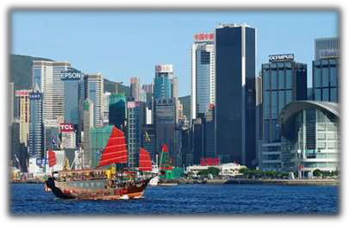

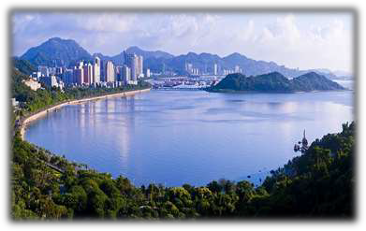
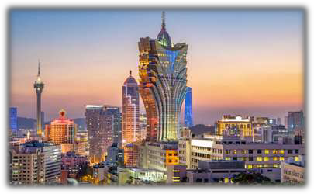
Guangzhou (29 m
in)
Hong Kong (18 min)
Shenzhen
Zhuhai (by HZM bridge)
Macau (by HZM bridge)

Slide 17
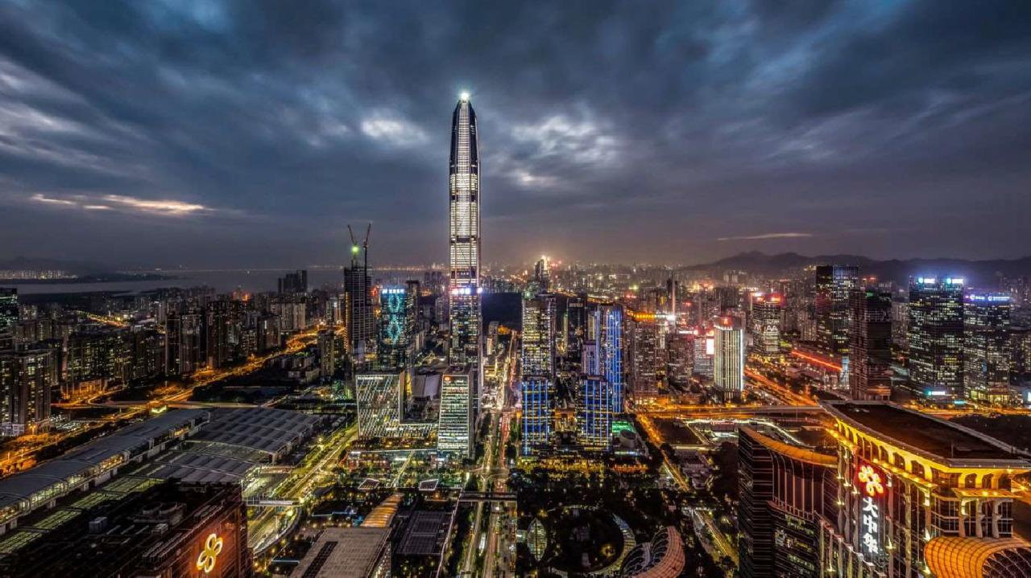




Slide 18
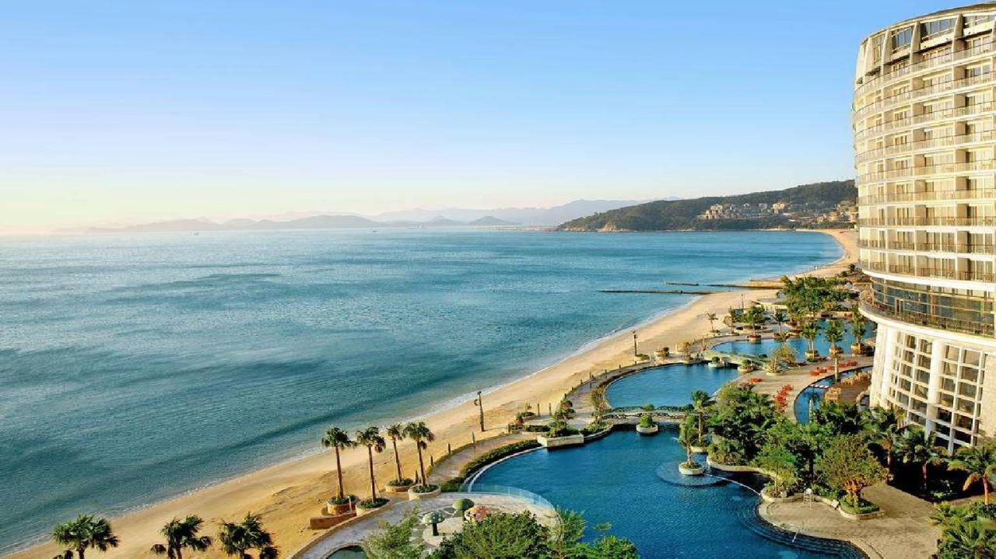






Slide 19



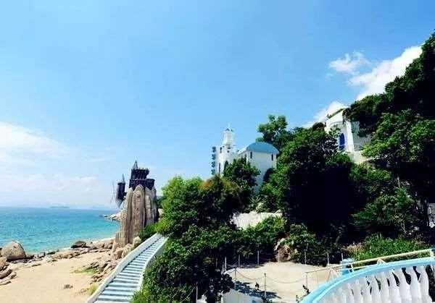

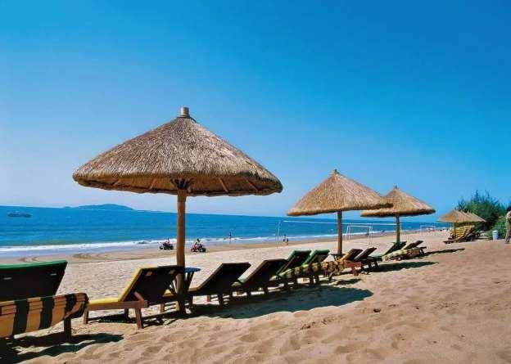

Slide 20
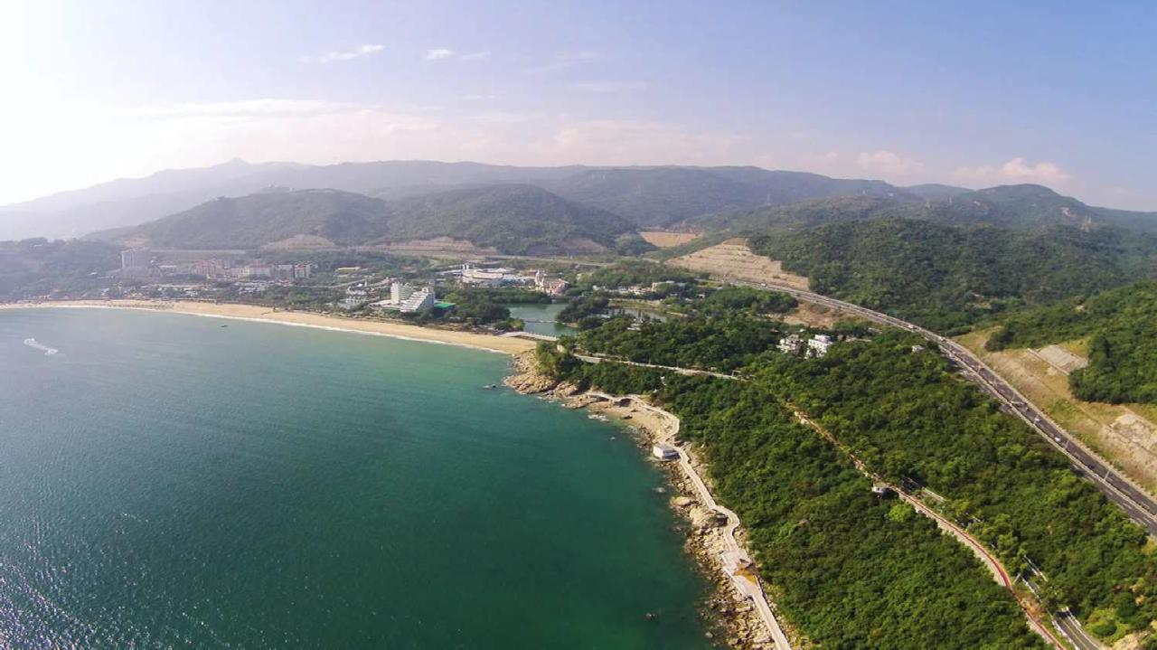






Slide 21
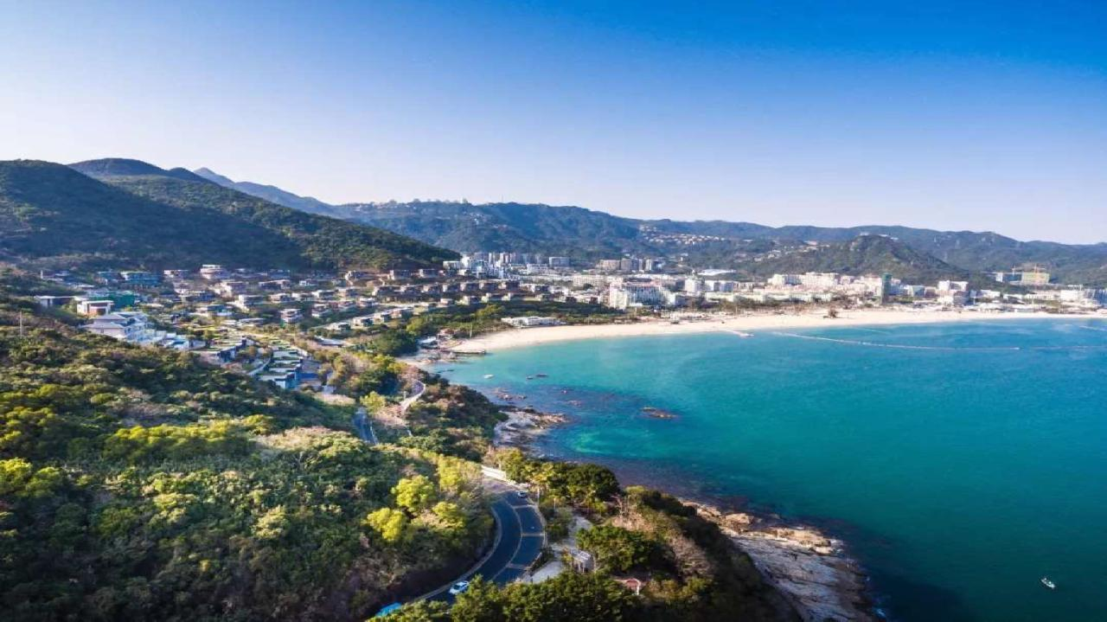




Slide 22
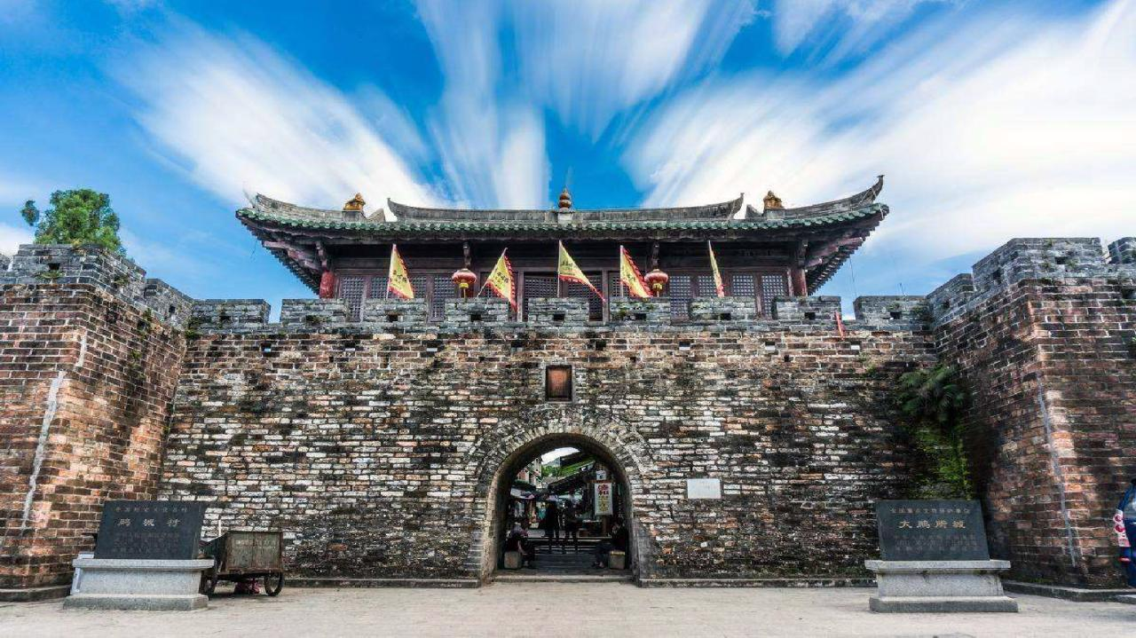

Slide 23
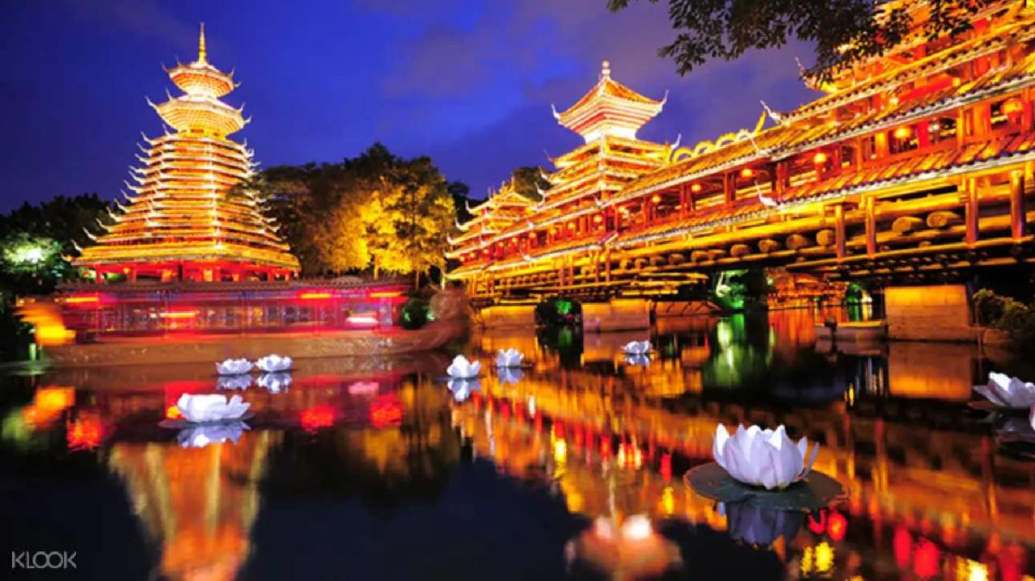







Slide 24
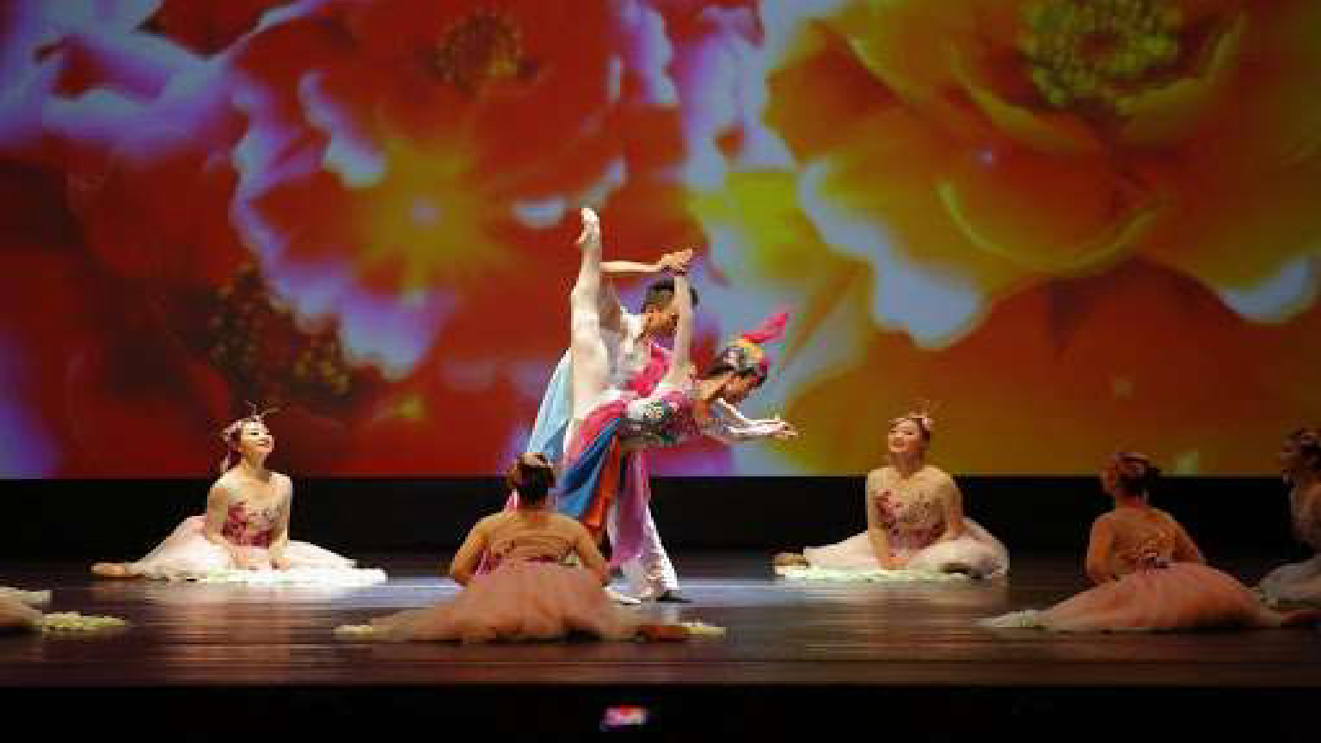



Slide 25



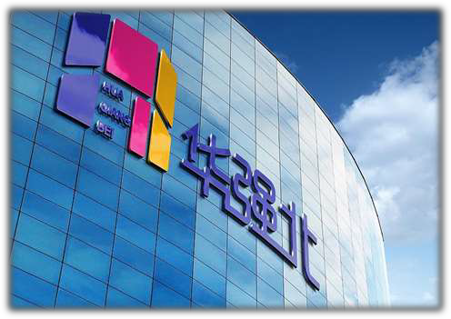
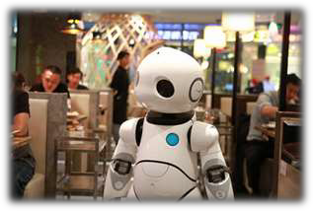
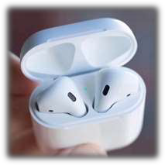





Slide 26


Guangzhou (29 min)
Hong Kong (18 min)
Shenzhen
Zhuhai (by HZM bridge)
Macau (by HZM bridge)

Slide 27









Guangzhou
Guangzhou Opera House
Traditional Chinese Medicine Market
Fall Of Canton Tower
Buddhist Rituals at Guangxiao Temple
Pearl River Night Cruise

Slide 28



Guangzhou (29 min)
Hong Kong (18 min)
Shenzhen
Zhuhai (by HZM bridge)
Macau (by HZM bridge)

Slide 29
Sands • Macau
Jiuzhou Port • Zhuhai

Slide 30

Guangzhou (29 min)
Hong Kong (18 min)
Shenzhen
Zhuhai (by HZM bridge)
Macau (by HZM bridge)

Slide 31







Disneyland
Victoria Harbour
Victoria Peak
Lan Kwai Fong

Slide 32















Slide 33







24 airlines serving 83 non-stop domestic airports and 22 non-stop international destinations

Slide 34

150 non-stop domestic and
international destinations in 45
countries/areas, with direct airport shuttle services to Shenzhen.

Slide 35






Dynamic
Location
Diverse Team
Delightful
Weather

Slide 36






Huang, Thomas S. University of Illinois (1936-2020)

Slide 37






Honorary Chairs
Chellappa, Rama University of Maryland
Gao, Wen
Peking University & Peng Cheng Lab
Shapiro, Linda University of Washington

Slide 38







General Chairs
Chen, Xilin
Institute of Computing Technology, CAS
Luo, Jiebo
University of Rochester
Shah, Mubarak University of Central Florida
Van Gool, Luc ETH Zurich & KU Leuven

Slide 39








Program Chairs
Akata, Zeynep
University of Tübingen
Hays, James
Georgia Tech
Leibe, Bastian
RWTH Aschen University
Qi, Guo-Jun
Futurewei Technologies
Shen, Chunhua
University of Adelaide

Slide 40








Finance Chairs
Local Chairs
Camps, Octavia Northeastern University
Shan, Shiguang Institute of Computing Technology, CAS
Liang, Xiaodan
Sun Yat-sen University
Ni, Dong
Shenzhen University
Tian, Yonghong Peking University & Peng Cheng Lab

Slide 41


Slide 42















Slide 43










Slide 44

Hotel | Straight distance from the convention center | Room type | Nightly rate (in Chinese Yuan)
Four Seasons Hotel Shenzhen | 0.23 km | Deluxe room (Double/Twin) | 1600
 |  | Executive Suite | 2100
The Ritz-Carlton Shenzhen | 0.3 km | Deluxe room (Double/Twin) | 1550
 |  | Executive Suite | 2900
Sheraton Shenzhen Futian Hotel | 0.51 km | Deluxe room (Double/Twin) | 1000
 |  | Executive Suite | 1800
Futian Shangri-La Hotel | 0.58 km | Deluxe room (Double/Twin) | 1200
 |  | Executive Suite | 2600
Vienna Hotel | 0.72 km | Deluxe room | 350
Jinzhonghuan Hotel | 0.44 km | standard room | 300
Aegean Art Hotel | 0.72 km | standard room | 320

Slide 45
















Reserved area

Slide 46






Room # | Used for | Size | Theater | Classroom | Banquet
Hall 2 (Hall 2A&2B) | Opening ceremony, keynote/oral sessions | 15,000 m² | 12,000 | 5,800 | 9,000
Hall 4 (Hall 4A&4B) | Exhibitions (80-120 booths) & Poster session 1 | 7,500 m² | 6,000 | 2,900 | 4,500
Hall 5 | Poster session 2, W&T, and Coffee breaks | 3,000 m² | 2,200 | 1,100 | 1,700
Rooms on 3rd, 5th, 6th Floor | breakout sessions (W&T) | 90-1,847 m² | 70-1200 | 40-600 | 72-960

Slide 47
Proposed ICCV 25 Agenda & Meeting Spaces
December 14-15, December 20, 2025 | 10-20 breakout sessions for Tutorials & Workshops (Multiple meeting rooms in Hall 5 & on 3rd, 5th, 5th floors)
December 16, 2025 (Main Conference Day 1) | Opening Ceremony & Award Session (Hall 2)
 | Oral Session 1 (Hall 2A) | Oral Session 2 (Hall 2B) | Poster Session 1 (Hall 4A) | Poster Session 2 (Hall 5) | Exhibitions (Hall 4B)
 | Reception (Hall 2)
 | CVF/PAMI TC Meeting (Hall 2)
December 17, 2025 (Main Conference Day 2) | Keynote Session (Hall 2)
 | Oral Session 1 (Hall 2A) | Oral Session 2 (Hall 2B) | Poster Session 1 (Hall 4A) | Poster Session 2 (Hall 5) | Exhibitions (Hall 4B)
 | Banquet (Hall 2)
December 18-19 (Main Conference Day 3-4) | Keynote Session (Hall 2)
 | Oral Session 1 (Hall 2A) | Oral Session 2 (Hall 2B) | Poster Session 1 (Hall 4A) | Poster Session 2 (Hall 5) | Exhibitions (Hall 4B)

Slide 48





Slide 49






Slide 50




Slide 51








